Slide 1
Komut satırı

Slide 2
Neden komut satırı?
Use not limited to GUI design
No need to obey GUI’s rules
GUI applications tend to be less stable
Easier to hack command-line tools
Command line applications usually “do the job” better
Repeatablilty (no memory from previous session)
Scriptability
Automation
Notes:
Quick and Dirty Bash Eli Billauer
A shell is a command interpreter. Commands can be executable files or built-ins. Commands can be bundled together into a script which a shell program executes. How the commands are packaged and wired together, using variables, functions, and control-flow operators makes up the shell's scripting language.

Slide 3
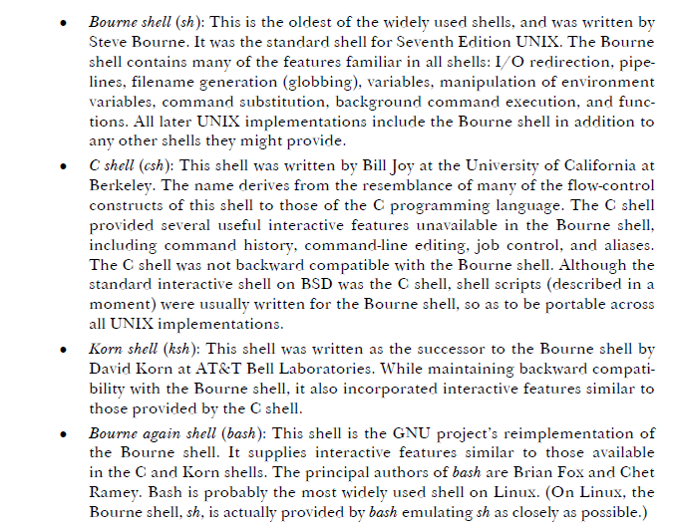
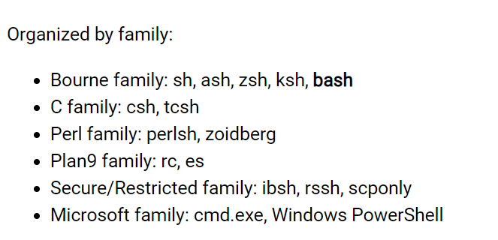
Kabuklar

Slide 4
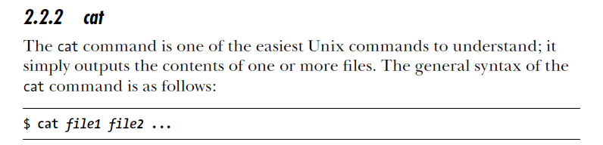
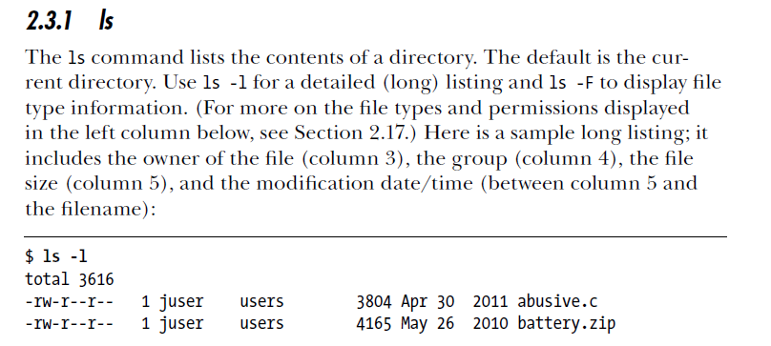
Temel komutlar

Slide 5
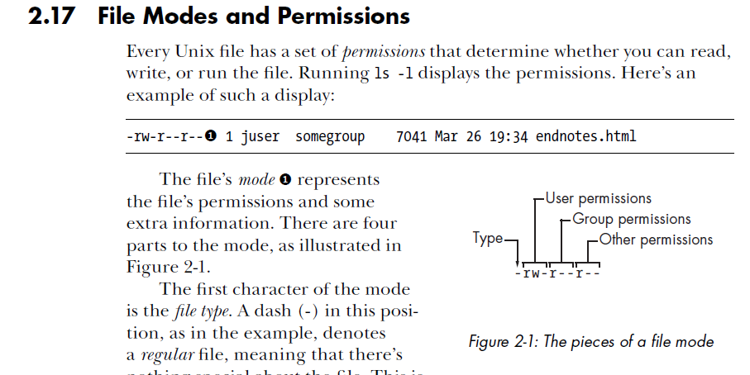
Temel komutlar

Slide 6
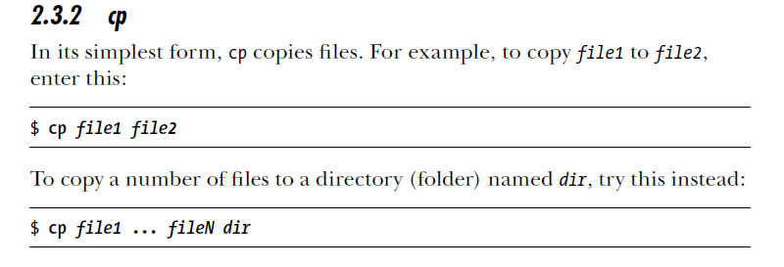
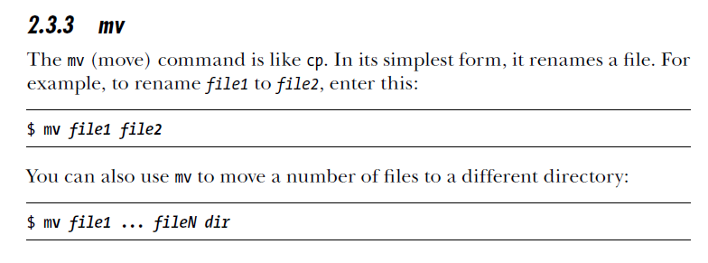
Temel komutlar

Slide 7
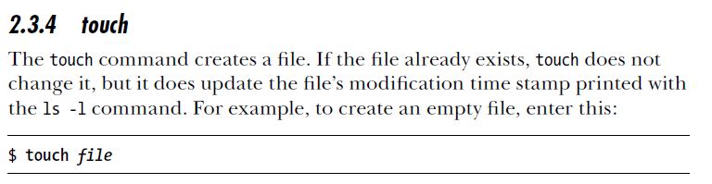
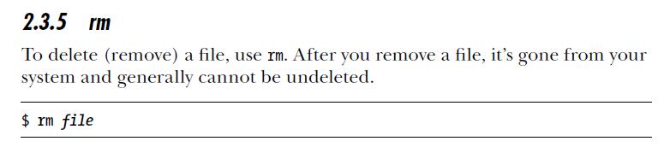
Temel komutlar

Slide 8
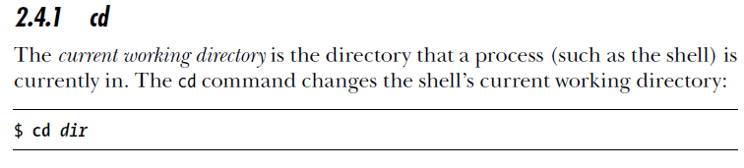
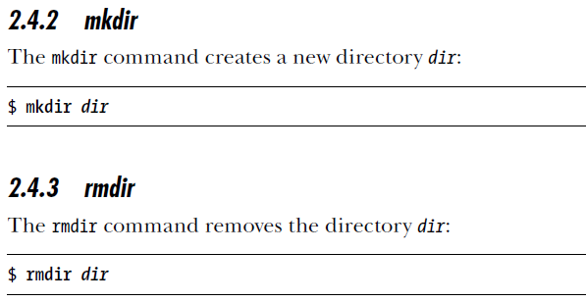
Temel komutlar

Slide 9
Temel komutlar
man
file
less
grep
pwd

Slide 10

Kaynaklar

